Slide 1
Interactive Visual Data Analysis
04 – Visual mapping

Slide 2
Objectives
How to build a visual representation of data: Learn about the basic building blocks
How can data be encoded visually: Learn the fundamentals of mapping data to visual representations

Slide 3
Overview
Visual encoding
Marks and visual variables
Visual mapping
Presentation
Presenting marks and views on the display

Slide 4
Motivation
Visual representations are most crucial for visual data analysis
Many different options for mapping data to visual representations
Visual representations should fulfill the quality criteria expressiveness, effectiveness, and efficiency
The representation effect:
“
The representation effect: Human performance varies enormously (10–100:1) with different representations.
— Hanrahan, 2009

Slide 5
Motivation
Illustration of the representation effect
Data: Temporal data with number of people reported sick per day
Representation: Visual mapping using different visualization techniques and different parameterizations
Line plot
Spiral display
Cycle length 32 days
Cycle length 28 days

Slide 6
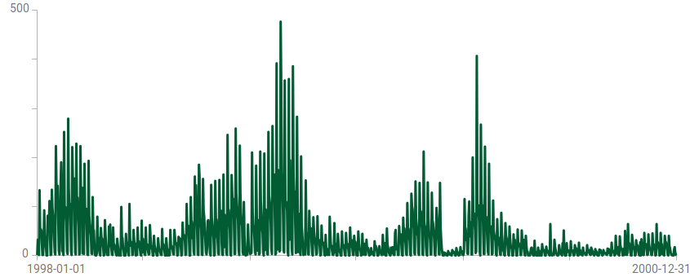
Motivation
Illustration of the representation effect
Line plot
We can locate peaks
We see phases of moderate and low numbers of cases
We do not see a clear trend
Think about: Are there any cyclic patterns?
Notes:
No, we certainly cannot see any cyclic pattern. But is that a fact from the data or the inability of the line plot to show us cyclic patterns?

Slide 7
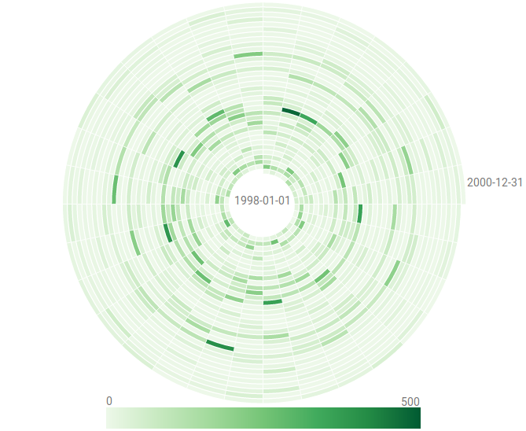
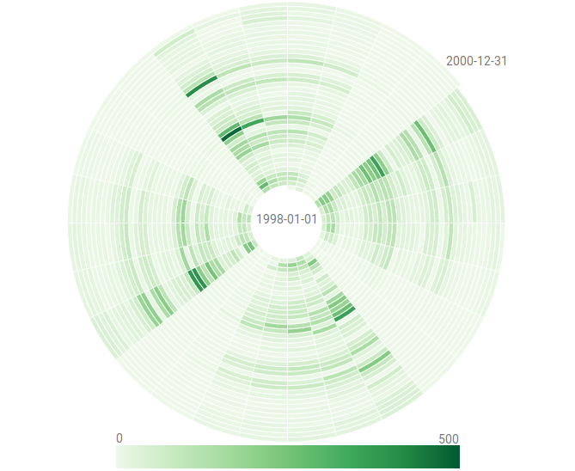
Motivation
Illustration of the representation effect
Spiral display
Data color-coded along spiral
With cycle length 32, we cannot see any pattern
With cycle length 28, we see a clear cyclic pattern
Think about: What do these patterns tell us?
Think about: What else can we see?
Cycle length 28 days
Cycle length 32 days
Notes:
The pattern is related to the weekly cycle of many people reporting sick early in the week and only few to no people reporting sick in the middle of the week and on weekends.
From inside to outside, we can also see a seasonal pattern with lower numbers reported in summer and higher numbers winter.

Slide 8
Motivation
Illustration of the representation effect
We have seen how different visual representations can or cannot support different analysis questions
Peaks can be easily identified and located in time using the line plot, yet cyclic patterns are not visible
A color-coded spiral display (if cycle length is set appropriately) can show us recurring and seasonal patterns in the data, identifying peaks is possible as well, but locating them in time is more difficult
Bottom line: We need to design for the data and the task at hand!

Slide 9
Visual encoding and presentation
For designing high-quality visual representations we need to know
How to encode data visually?
Visual encoding
How to present data meaningfully?
Presentation

Slide 10
Visual encoding
Fundamental ideas for data graphics established by French cartographer Jacques Bertin (1967, 1983)
Visual representations are composed of
Marks (graphical primitives)
Visual variables (visual appearance of primitives)
Visualizing data means creating graphical primitives and specifying their visual appearance according to the underlying data.

Slide 11
Visual encoding
Marks
Basic building blocks of visual representations
Distinguish different types of marks based on their dimensionality (0D points, 1D lines, 2D areas, 3D bodies)
Visual variables
Carry the actual information
Can be varied within a reasonable range
Different variations can be perceived as different

Slide 12
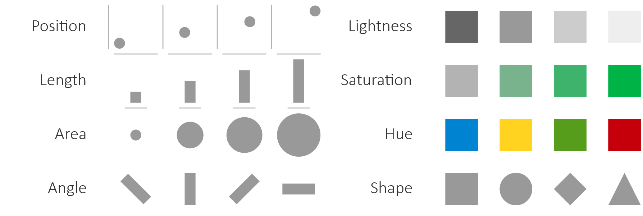
Visual encoding
Visual variables

Slide 13
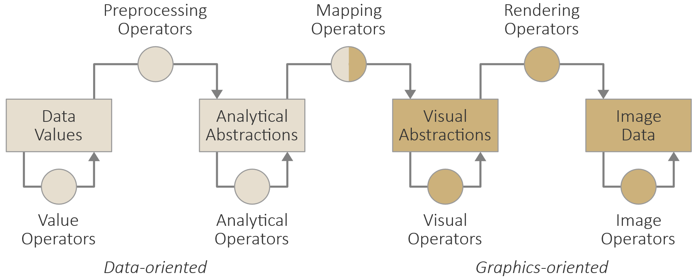
Visual encoding
Visualization pipeline from Lecture 3.
At the heart of visual encoding, we map data variables to visual variables (of marks)
“Visual mapping” transformation operator in the visualization pipeline: From analytical abstractions to visual abstractions
Two questions need to be answered:
What to map?
How to map?

Slide 14
Visual encoding
What to map?
Student: “Which data variable(s) should be mapped to which visual variable(s)?”
Teacher: “You should map the most relevant data variables to the most effective visual variables!”
Student: “But which data variables are relevant and which visual variables are the most effective?”
Teacher: “Relevant data variables are prescribed by the analysis tasks and the most effective visual variables are data-dependent and have been found via perceptual studies!”

Slide 15
Visual encoding
What to map?
Different visual variables are differently effective for nominal, ordinal, and quantitative data (Cleveland and McGill, 1984) and (Heer and Bostock, 2010)
“Proportionate”
“Order”
“Distinguish”
Adapted from Mackinlay and Winslow (2014)

Slide 16
Visual encoding
How to map?
Student: “Which values or intervals of a data variable should be mapped to which portions of a visual variable?”
Teacher: “Map the data such that the important information stands out! Ideally, the important information can be perceived pre-attentively.”
Student: “Pre-att.. What?”
Teacher: “Pre-attentive. Things that can be perceived in the blink of an eye without requiring our full attention are perceived pre-attentively.”

Slide 17
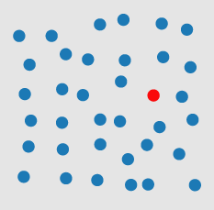
Visual encoding
Excurse: Pre-attentive processing
https://www.csc2.ncsu.edu/faculty/healey/PP/

Slide 18
Visual encoding
How to map? – By the example of color-coding
Ideally, each data value is mapped to a unique identifiable color, though this ideal is limited by output device and human perception
General recommendations
Use perceptual color spaces (CIE lab, HSV, etc.), not technical color spaces (RGB, CMYK)
Use perceptually uniform color maps (perceived color differences are proportional to differences in data), not just some color maps
Use well-established and tested color maps, not just some fancy colors
https://colorbrewer2.org

Slide 19
Visual encoding
How to map? – By the example of color-coding
Data: Individual values vs. classes → Continuous vs. segmented maps
Task: Identify vs. locate → Uniform vs. highlighting maps

Slide 20
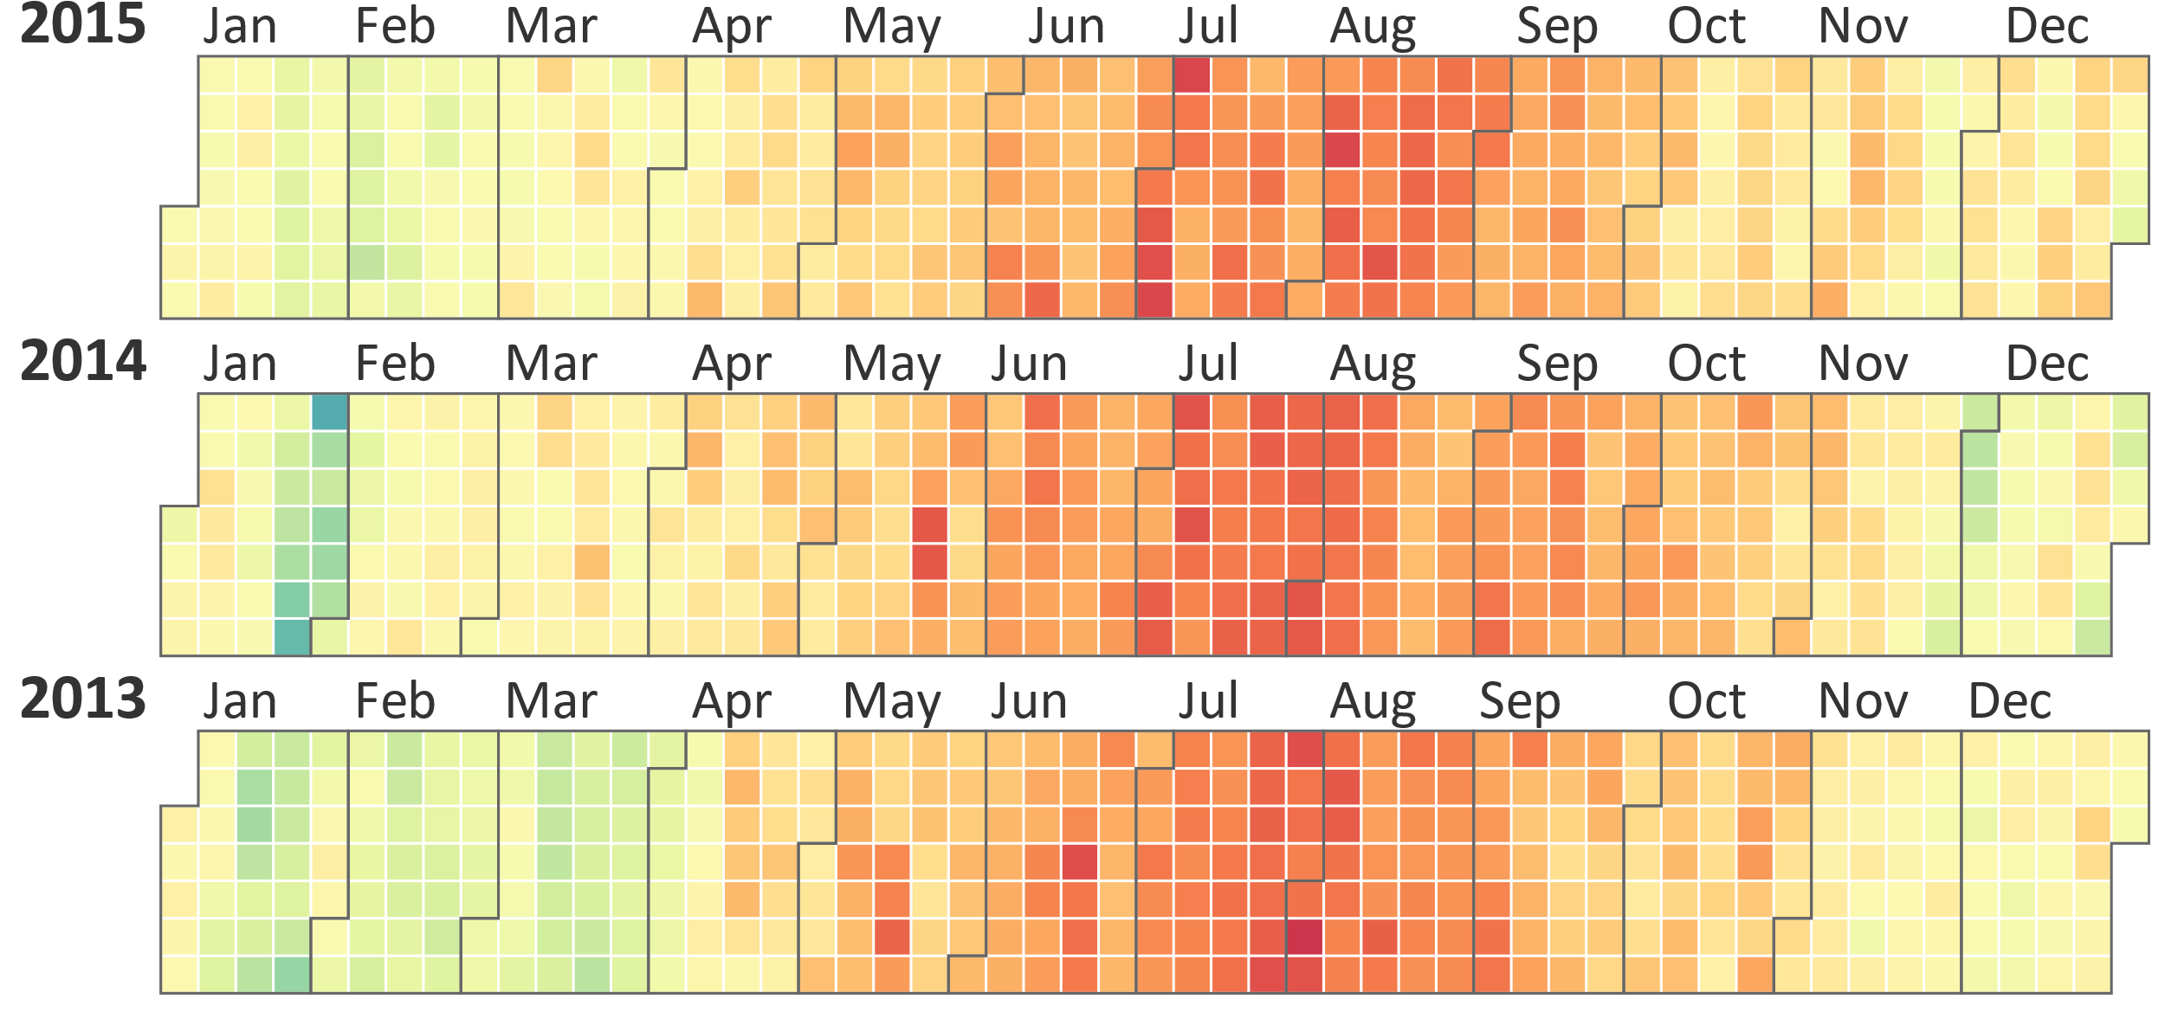
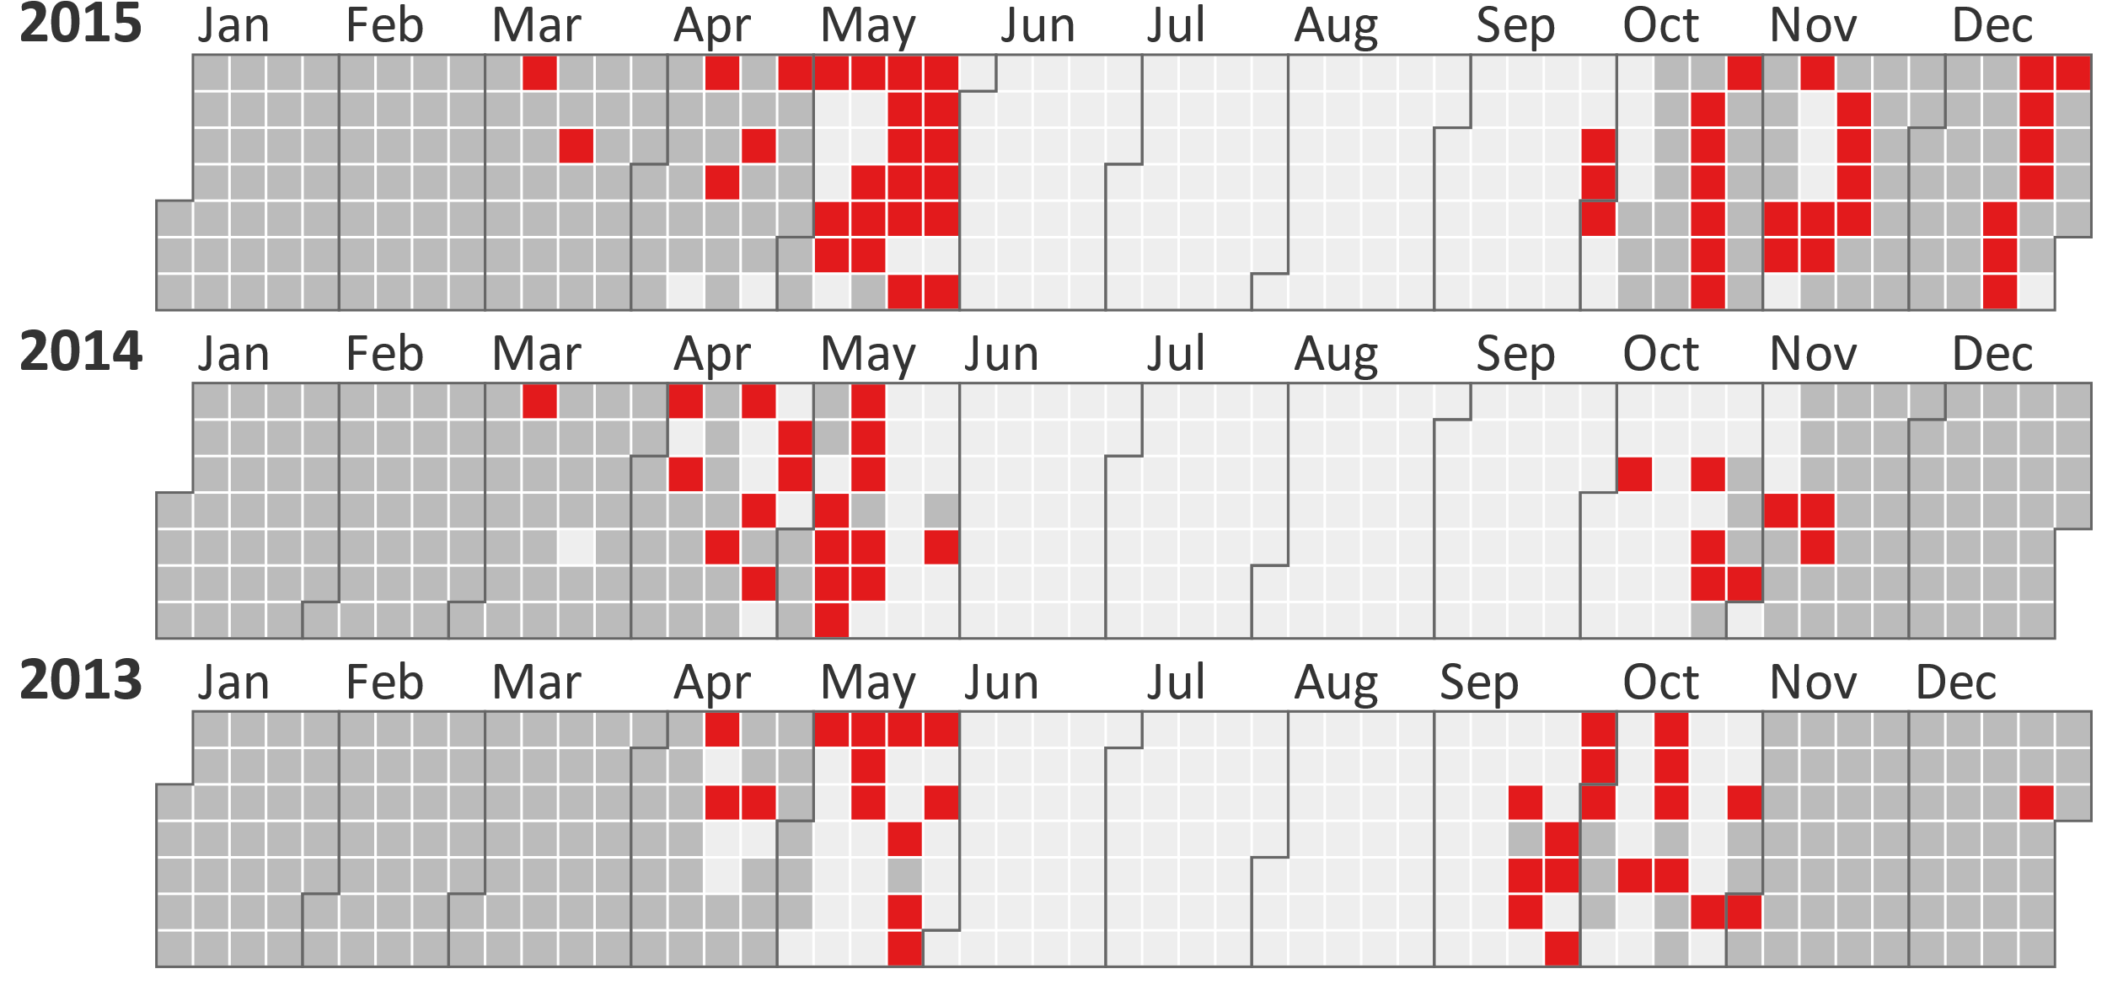
Visual encoding
How to map? – By the example of color-coding

Slide 21
Visual encoding
How to map? – By the example of color-coding
Basic mapping of a range of numeric values to colors
Normalize data value $t=\frac{d_{val}−d_{min}}{d_{max}−d_{min}}$
Linearly map normalized value to color $v_{val}=\left(1−t\right)∙v_{min}+t∙v_{max}$

Slide 22
Visual encoding
How to map? – By the example of color-coding
Basic mapping of nominal values to colors
Assign each nominal value to distinct color from qualitative color map
Colors must be clearly differentiable
Colors must not suggest any order
Usually possible for up to 12 colors
Map nominal values to numbers (before mapping these to colors)
Give nominal values a quantitative meaning based on how data are distributed
More details in Rosario et al. (2004)

Slide 23
Visual encoding
How to map? – By the example of color-coding
Some practical concerns…
Color legend labels can be difficult to interpret
Linear mapping might not go well with the data’s distribution
Color mapping for visual comparison
… and their solutions
Value range expansion
Logarithmic mapping
Box-whisker mapping
Merging of color maps

Slide 24
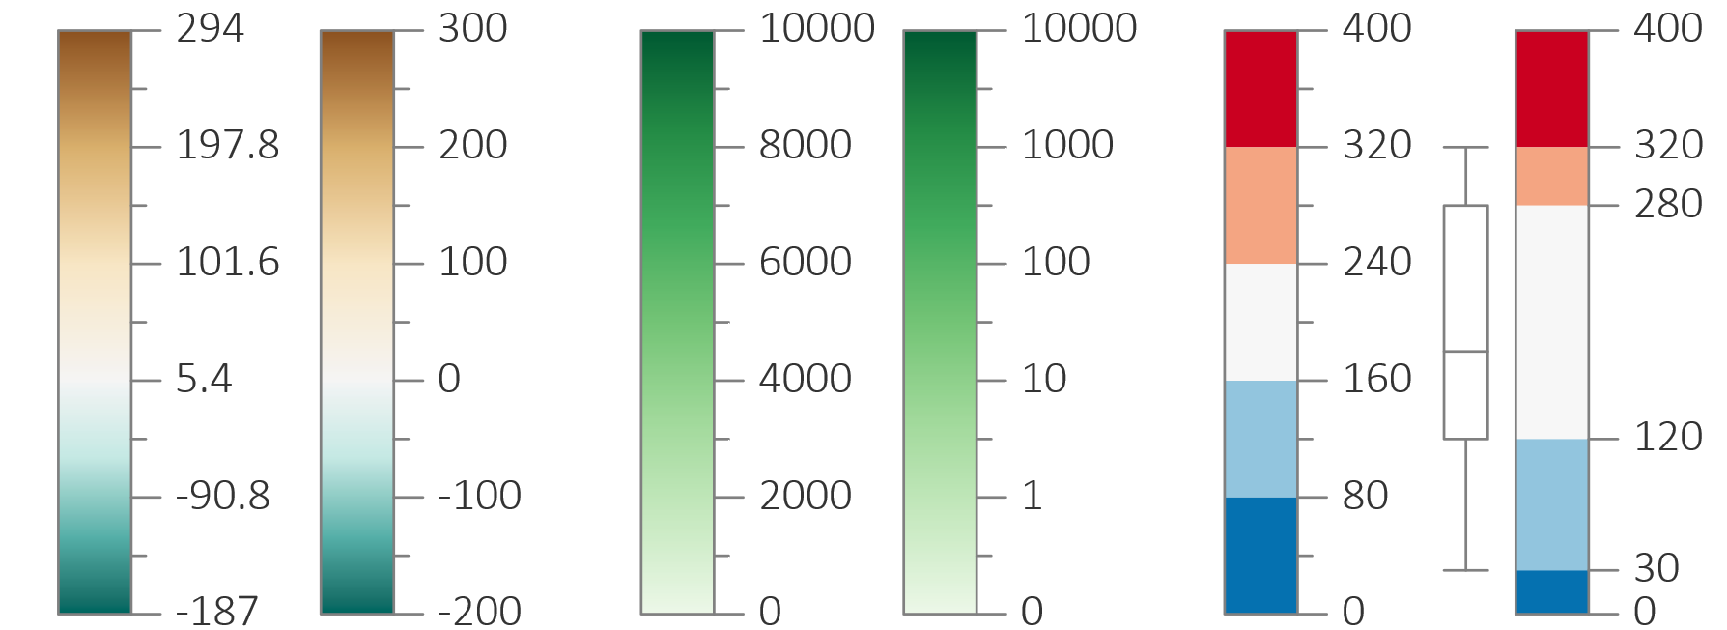
Visual encoding
How to map? – By the example of color-coding
Value range expansion Make labels multiples of 2 or powers of 10
Logarithmic mapping $t=\frac{\log{(d_{val}−d_{min})}}{\log{(d_{max}−d_{min}})}$
Box-Whisker mapping Map based on data distribution’s interquartile range

Slide 25
Visual encoding
How to map? – By the example of color-coding
Color-coding for visual comparison tasks
Conflicting needs
Need to distinguish values of individual variables → Calls for separate color maps, but comparison not possible
Need to be able to compare values between variables → Calls for global color map, but local data variations might get washed out
Better solution: Merging of color maps → Comparison is possible, individual values remain distinguishable

Slide 26
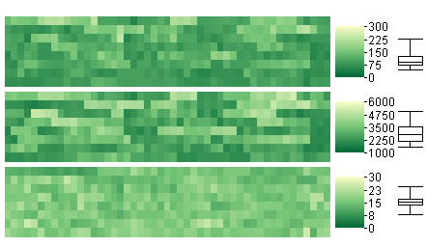
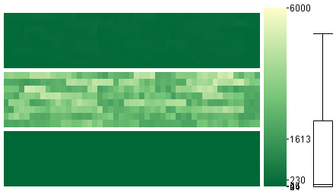
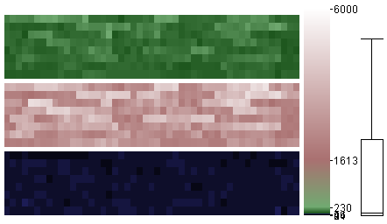
Visual encoding
How to map? – By the example of color-coding
Color-coding for visual comparison tasks
Individual color maps per variable Values differentiable but not comparable
Global color map for all variables Values comparable but not differentiable
Dedicated comparison color map Values comparable and also differentiable (to a certain degree)

Slide 27
Visual encoding
Using multiple visual variables
By combining multiple visual variables, more expressive, effective, and efficient visual encoding can be obtained
Two basic options
1-to-n mapping: 1 data value mapped to n visual variables
Can make visual representation more effective and efficient (make data easier to see)
n-to-n mapping: n data values mapped to n visual variables
Can make visual representation more expressive (show more data)
Important: Don’t overdo!

Slide 28
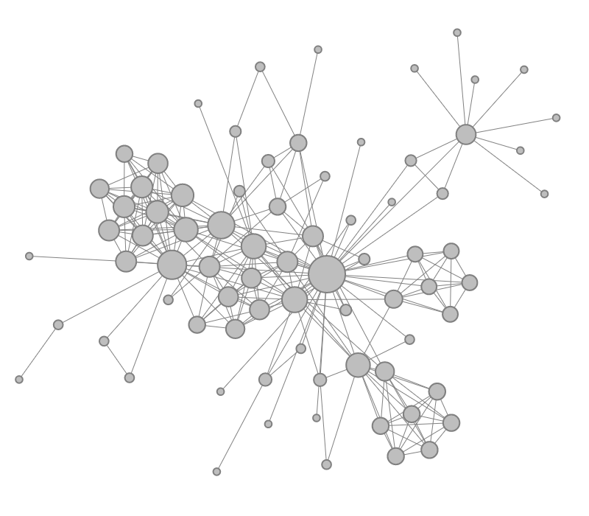
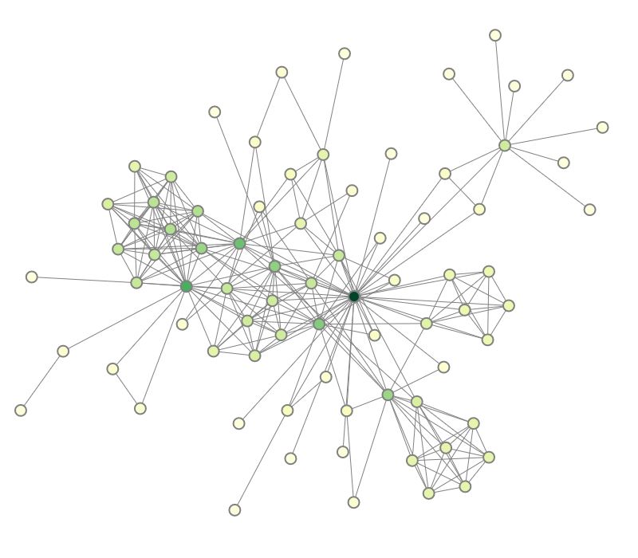
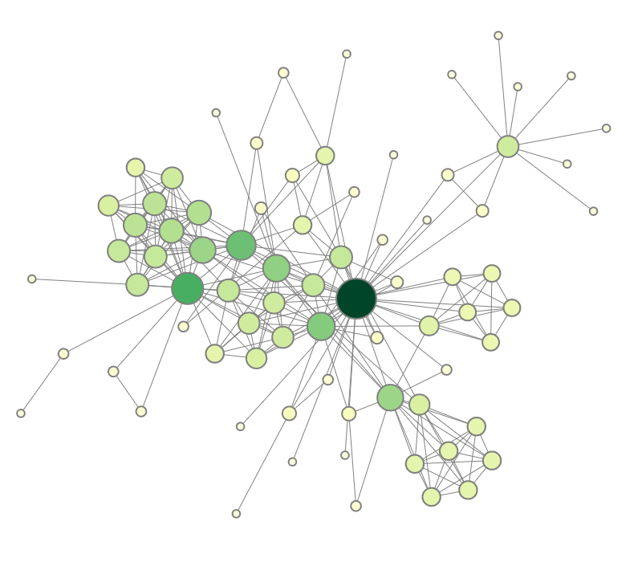
Visual encoding
1-to-n mapping
Example: Node-link diagram from first lecture
Map node degree to size and color
+
Size
Color
Size + Color
https://vcg.informatik.uni-rostock.de/~ct/software/iGraph.js/iGraph.html

Slide 29
Visual encoding
1-to-n mapping
Example: Two-tone coloring combines color plus length (Saito et al., 2005)
Properties of mapping data to color and length
Color: Data can be estimated quickly, but are more difficult to read precisely
Length: Data can be read precisely, but visualization requires substantial display space
Basic idea: Combine advantages of color and length
Two colors guide the rough estimation of data values
The proportion of the two colors (length) allows reading the precise data value
Result:
Values can be quickly estimated and precisely read
Only little display space is required

Slide 30
Visual encoding
1-to-n mapping
Example: Two-tone coloring combines color plus length (Saito et al., 2005)
Continuous color
Segmented color
Tow-tone color

Slide 31
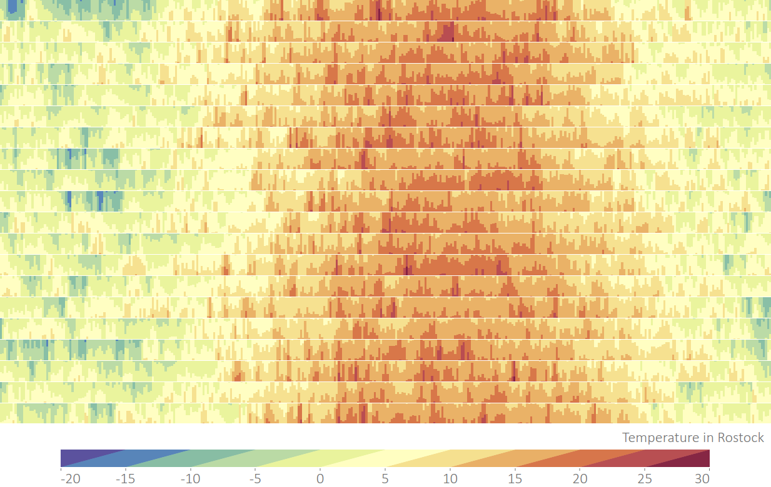
Visual encoding
This kind of visual representation also goes by the name of horizon graph.

Slide 32
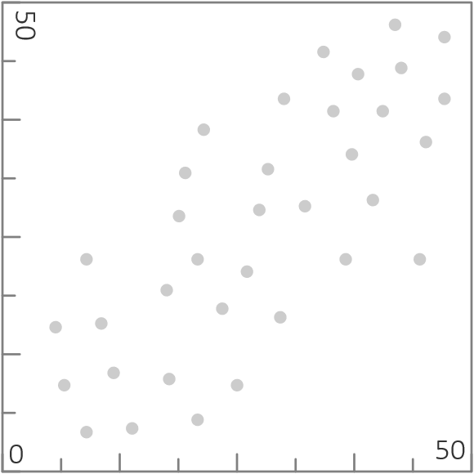
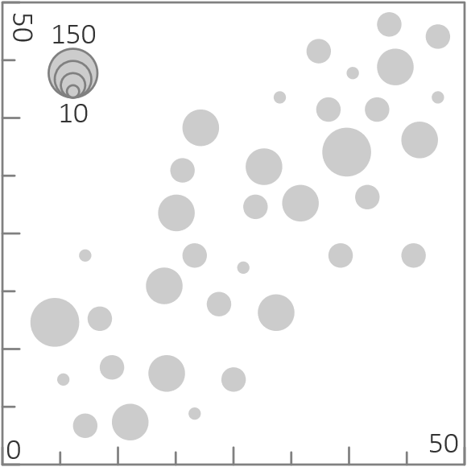
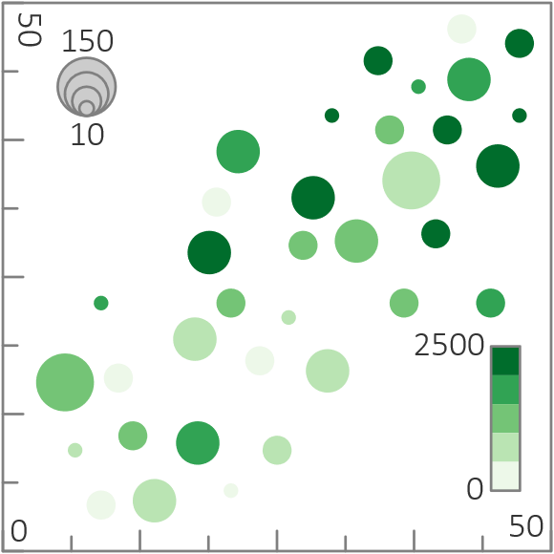
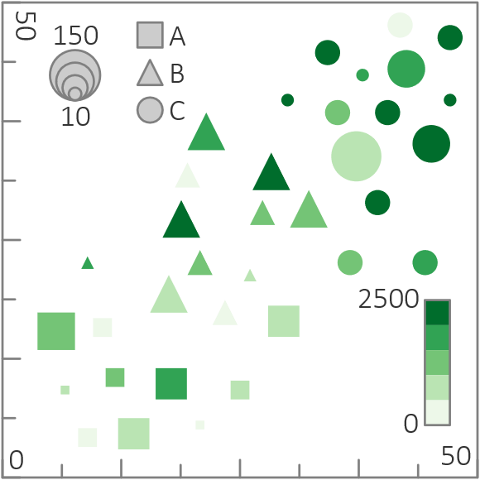
Visual encoding
n-to-n mapping
Example: Scatter plot encoding 5 variables
2 variables encoded in position
1 more var. encoded via size
1 more var. encoded by color
1 more var. encoded in shape

Slide 33
Visual encoding
Using multiple visual variables
Important: Don’t overdo!
“
In anything at all, perfection is finally attained not when there is no longer anything to add, but when there is no longer anything to take away [..] — de Saint-Exupéry, 1939

Slide 34
Visual encoding
Summary
Basic ingredients: Marks and visual variables
Two design questions:
What to map? → “Map most relevant data variables to most effective visual variables!”
How to map? → Make important information pre-attentively perceivable → Basic methods can be enhanced in various ways
Value range expansion
Visual mapping based on data distribution
Use of multiple visual variables

Slide 35
Visual encoding and presentation
For designing high-quality visual representations we need to know
How to encode data visually?
Visual encoding
How to present data meaningfully?
Presentation

Slide 36
Presentation
Visual encoding is concerned with generating marks and assigning their visual appearance and compile them to views
Presentation is concerned with presenting marks and views to users
Three key questions are relevant:
Should we present the marks in 2D or 3D?
Should we present all marks or focus on subsets of interest?
How can we arrange multiple views so that users can use them in concert?

Slide 37
Presentation
1. Presenting in 2D or 3D?
Think about: What are advantages and disadvantages of 2D and 3D visual representations?

Slide 38
Presentation
1. Presenting in 2D or 3D?
2D is arguably more abstract and easier to explore
Human perception naturally more adept to 3 dimensions
3rd dimension can serve as carrier of additional information
3D can be more difficult to interpret due to projection and perspective distortion
In 3D, occlusion can be more of a problem than in 2D
There is no definite answer w.r.t. to 2D or 3D
Decision must be made carefully on case-by-case basis

Slide 39
Presentation
2. Presenting all data or data of interest?
Two essential communicative goals
Convey an overall picture
Provide details where necessary
Both goals become more and more difficult to achieve for larger data
Conveying overview usually requires neglecting details
Presenting details usually makes it necessary to sacrifice completeness
Two fundamental strategies
Overview+detail
Focus+context

Slide 40
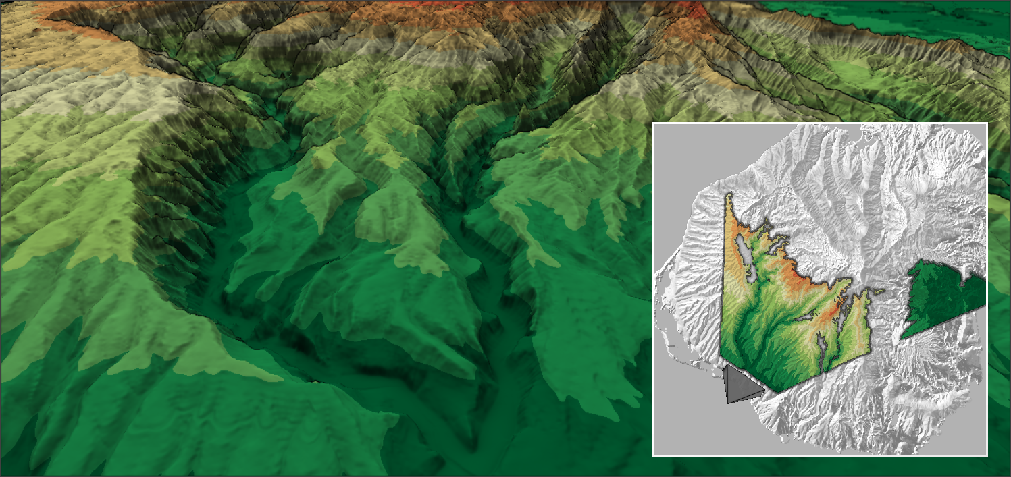
Presentation
2. Presenting all data or data of interest?
Overview + detail: Show two separate views
Overview
All data
Reduced detail
Detail view
Selected data
Full detail
Detail view
Overview

Slide 41
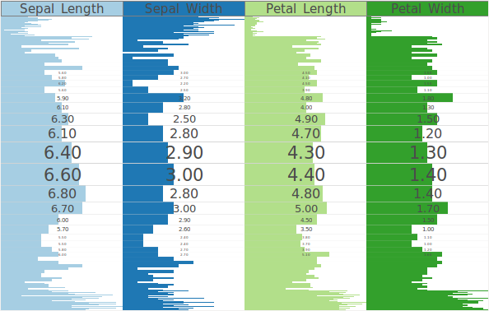
Presentation
2. Presenting all data or data of interest?
Focus + context: Smoothly embed in a single view
Focus
Selected data
Full detail
Context
All data
Reduced detail
The Table Lens is a focus+context technique, here implemented via a fisheye distortion mapping.
Context
Focus
Context

Slide 42
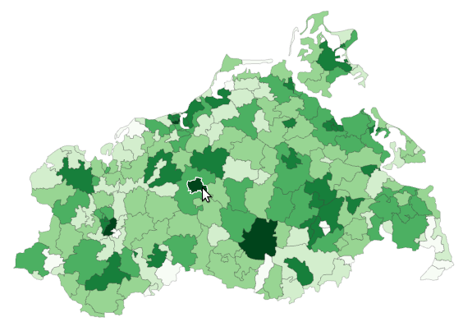
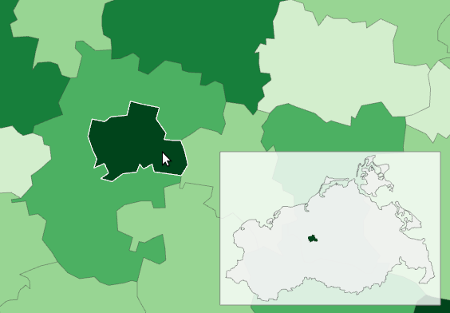
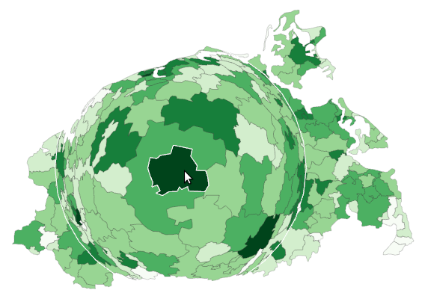
Presentation
2. Presenting all data or data of interest?
Comparison of overview + detail vs. focus + context
Regular map
Overview + detail (large detail, small overview)
Focus + context (fisheye distortion)

Slide 43
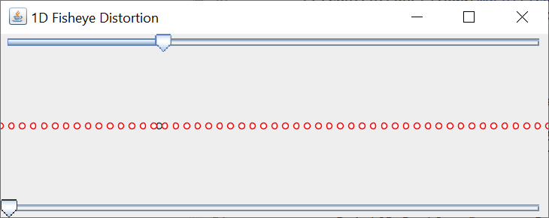
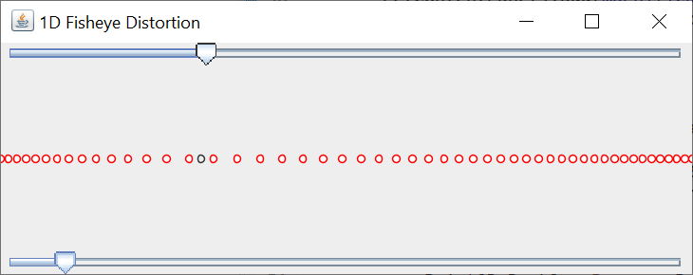
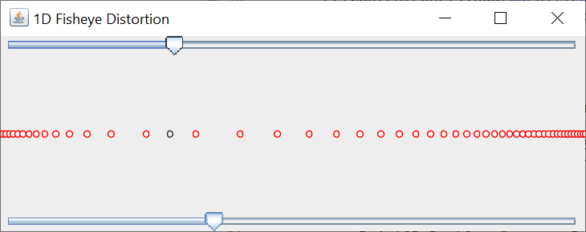
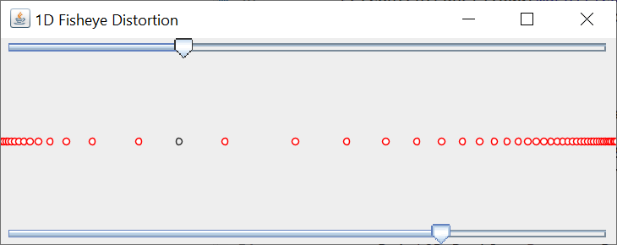
Presentation
2. Presenting all data or data of interest?
Fisheye distortion (Sarkar and Brown, 1994)
Push points that are close to the focus away from it
Parametric mapping from current distance (to focus) d to new distance d’
Magnification factor m defines how far points are pushed away from focus
Only affect points with d < d_{max}
$$d^{′}=d_{max}∙\frac{(m+1)∙\frac{d}{d_{max}}}{m∙\frac{d}{d_{max}}+1}$$

Slide 44
Presentation
3. Presenting multiple views in space or in time?
To understand complex data, we often need multiple views, each concentrating on different aspects of the data
Such multiple views can be presented
In space: Side by side
In time: One after the other

Slide 45
Presentation
3. Presenting multiple views in space or in time?
Arranging views in space
Fixed: Fixed arrangement designed by expert for efficiency
No effort required on user side
No flexibility (cannot adjust view size or adapt to device)
Free: Users arrange views freely
View arrangement can be costly to set up
Full flexibility
Constrained: Users refine pre-defined arrangement within reasonable bounds
Compromise between costs and flexibility
Useful constraints: Overlap-free partition of view space, maintain aspect ratio of views

Slide 46
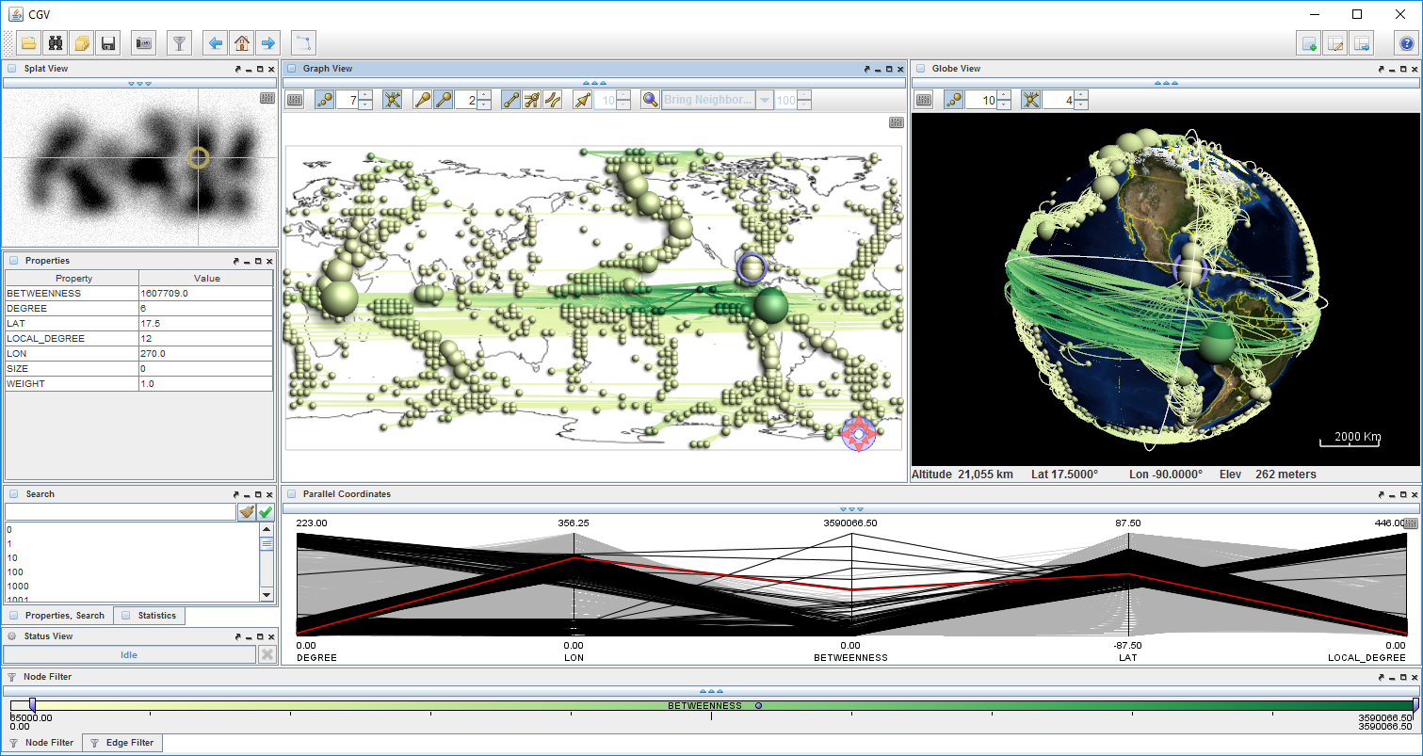
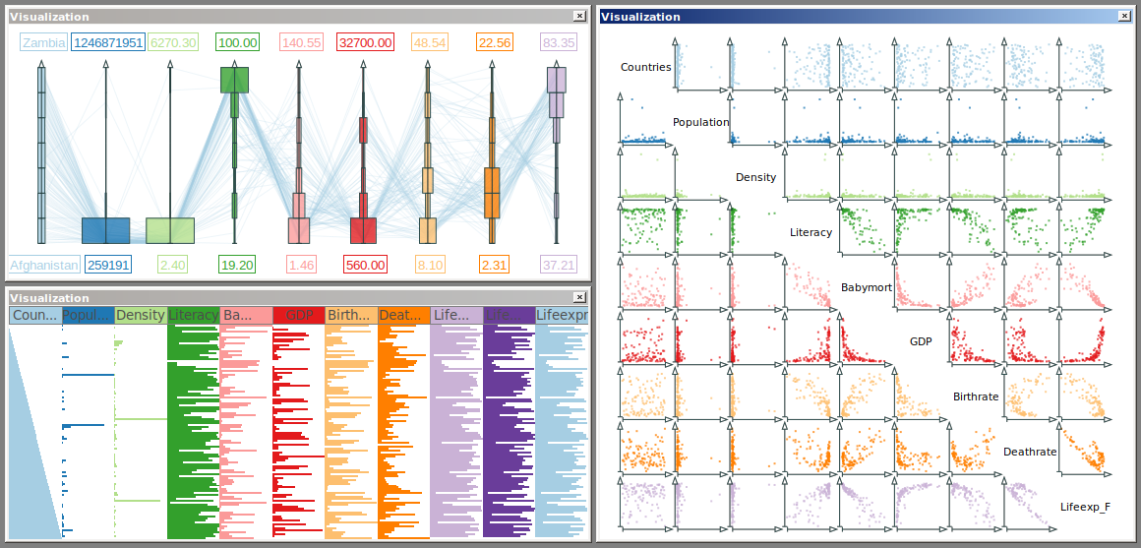
Presentation
3. Presenting multiple views in space or in time?
Arranging views in space
Graph visualization with multiple coordinated views
Multi-view visualization of multivariate data

Slide 47
Presentation
3. Presenting multiple views in space or in time?
Arranging views in space
Think about: How should a visual representation respond to size changes?
Answers can be found in recent research on “Responsive Visualization” (Hoffswell et al., 2020)
Notes:
Responsive visualization

Slide 48
Presentation
3. Presenting multiple views in space or in time?
Presenting multiple views in time
Sequencing views in time
Slide show: slow progression of views
Animation: many views per time unit (see assignments for learning more!)
Pros & cons
Spatial arrangement allows for detailed comparison
Temporal sequence is suited to represent development over time
Animations can be difficult to follow (need careful design and interactive control)

Slide 49
Summary
For designing high-quality visual representations we need to know
How to encode data visually?
How to present data meaningfully?
We now know how data can be encoded and presented visually. Next, we look at concrete visualization techniques for different data classes.

Slide 50
Assignments
Learn more about pre-attentive processing at https://www.csc2.ncsu.edu/faculty/healey/PP/!
Go to https://colorbrewer2.org and learn about sequential, diverging, and qualitative color scales!
Learn more about fisheye distortion at https://observablehq.com/@benmaier/a-visually-more-appealing-fisheye-function!
Read “Animation for Visualization: Opportunities and Drawbacks” by Danyel Fisher!

Slide 51
Questions
What does the representation effect tell us?
What are marks and visual variables? Give examples!
How would you select visual variables for the visual encoding?
Characterize color maps for identification and location tasks!
What is pre-attentive processing?
What types of color maps are suited for what types of data?
How can ColorBrewer help us find suitable color maps?
What are the advantages of using multiple visual variables?
What can be benefits and problems when presenting data in 3D?
What is the difference between overview+detail and focus+context?
How can views be arranged in space and be sequenced in time?

